Slide 1
3DFPN-HS2: 3D Feature Pyramid Network Based High Sensitivity and Specificity Pulmonary Nodule Detection
陈浩宇
2020.04.02

Slide 2
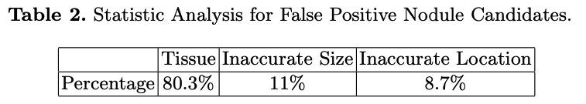
Challenges
Some normal tissues have similar appearances as nodules in CT images which cause high false positives by wrongly detecting these tissues as nodules.
The high discrepancy of the volume between nodules and the whole CT scan may cause missing detection of real nodules.
Notes:
1. 一些正常组织的形态学表现与CT图像中的结节相似，通过错误地将这些组织检测为结节，会引起高度假阳性。 2. 结节与整个CT扫描之间的体积差异很大，可能会导致漏检出真正的结节。
For example, the volume of a nodule with 10mm size in the diameter only occupied 0.059% of the volume of whole CT scan (in average 213 × 293 pixels with 281 slices). Furthermore, the size of pulmonary nodules can vary by as much as 10 times. For example, nodules in diameter can range from 3mm to 30mm in LUNA16 dataset.

Slide 3
Objective
Detect small volume nodules from large volume CT scans.
Differentiate nodules from tissues with similar appearances in CT images.

Slide 4
Motivation
Powerful deep network + Medical imaging insights
3DFPN benefits from the progress of state-of-the-art deep learning: 2D Feature Pyramid Network (FPN)
HS2 network benefits from the insight of medical images: the spatial variances within continuous CT slices of nodules and tissues are distributed differently.

Slide 5
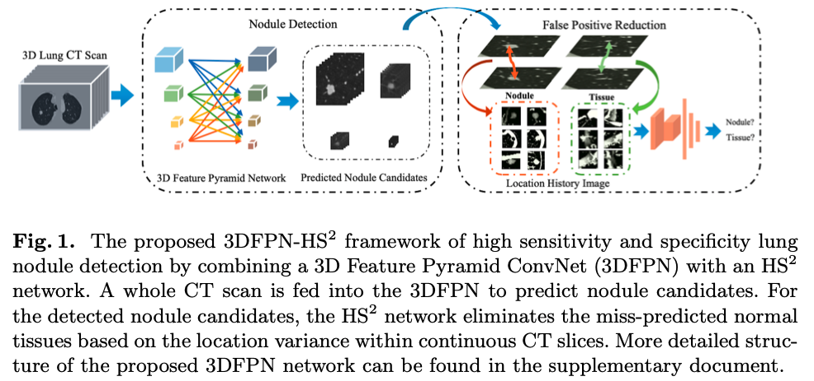
Method: Full Model

Slide 6
Method: 3D Feature Pyramid ConvNet
FPNs are good at detect objects at different scales
Four layers: integrates the low-level features by a max pooling layer and the down-sampled high-level features by deconvolution.
3DFPN predicts location with four parameters as [x, y, z, d]
[x, y] as the spatial coordinates at each CT slices
z as CT slice number
d as nodule diameter and a confidence score for each candidate

Slide 7
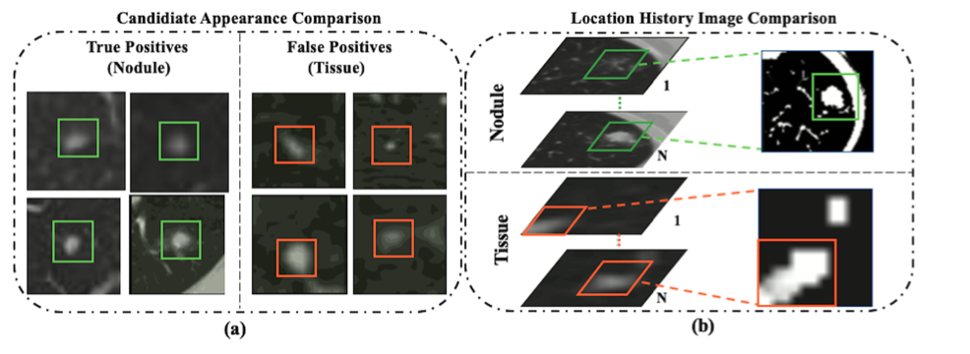
Method: HS2 Network

Slide 8
Method: HS2 Network
Outputs: refined predicted labels of true nodules and tissues.
2 convolution layers + 3 fully connected layers.

Slide 9
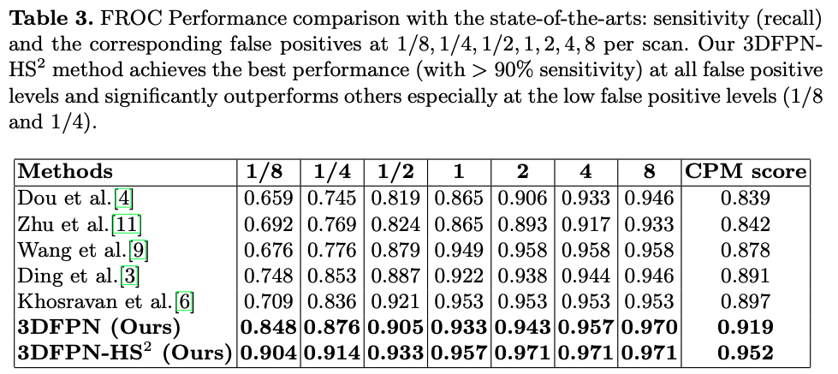
Result
LUNA16 challenge dataset
Consists of 1186 nodules in the size between 3 − 30 mm from 888 CT scans and agreed by at least 3 out of 4 radiologists.

Slide 10
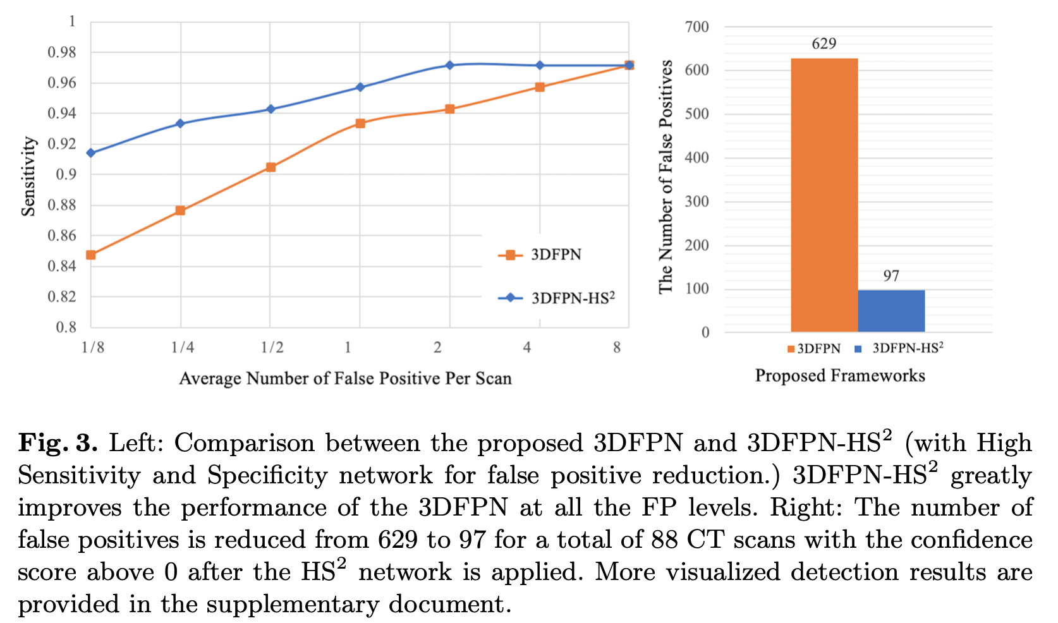
Result

